Slide 1
PARRC Online Assessment

Slide 2
What Families Need to Know About New Tests in Schools
November 2013
Notes:
_ PARCC tests are coming to elementary, middle and high schools in many states across the country.
_ It’s important that school communities understand the benefits of these new fair and accurate tests, which will replace current state assessments used to measure student progress from year to year in reading, writing and math.

Slide 3
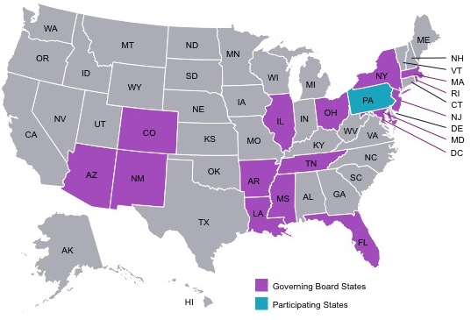
Who Will take PARCC Tests and When
17 states and the District of Columbia are working together to develop better reading, writing and math tests for their students
Tests are for grades 3-11
Field testing will take place in 2013-14 for about 10 percent of students in PARCC states
Schools will administer tests broadly in 2014-15
Notes:
_ By working together, states are developing shared tests of the highest quality at a reasonable cost and are ensuring that when students and families move from one state to another, such as military families, they know what to expect and what acceptable work held to high expectations looks like.
_ PARCC states expect there will be some minor glitches in the spring 2014 practice run, which will involve about 10 percent of students. PARCC will use the experience to create the best possible tests for all kids the following year. It's how we make the tests fair and accurate.

Slide 4
New Standards Require New Tests
PARCC tests are aligned to the new Common Core State Standards now in place in K-12 schools nationwide
In most states, the outgoing tests were not linked to these more rigorous reading, writing, and math standards
The Common State Core Standards are designed to better prepare students for college and the workforce
Notes:
_ Forty-five states and the District of Columbia have adopted and are implementing the Common Core State Standards in English language arts and math.
_ They are more rigorous than outgoing state standards and set clear expectations around what American students should know and be able to do upon graduating from high school in this globally competitive era.
_ The standards do not dictate what individual schools and educators should teach but set guidelines and expectations for each grade. States and school districts remain in control of curriculum and text books; there is still plenty of flexibility and room for creativity in schools and by teachers.
_ The new standards require new tests. You can’t have one without the other. They are a package deal. PARCC is closely aligned with the Common Core State Standards.

Slide 5
Widespread Support Among Parents for PARCC Rigor
PARCC tests are more meaningful and challenging than outgoing fill-in-the-bubble state tests
They measure essential skills, such as the ability to communicate effectively, reason well, and solve real-world problems
Parents want the increased rigor that comes with PARCC
More than two-thirds of parents are worried that their children could miss out on important future opportunities unless their education becomes more challenging.
Notes:
(Source: Poll released in October by national nonprofit America Achieves.)
_ Parents overwhelmingly support higher standards in schools. But you can’t have better standards without also creating better tests. And that’s where PARCC comes in. Just like the Common Core is meeting the desire of parents for higher standards in schools, PARCC is raising the bar when it comes to the quality of the tests kids take.
_ What’s more, PARCC tests include many long-form questions – giving kids a chance to truly show what they know and can do.
_ That’s a big difference from current state tests, which tend to rely heavily on multiple choice questions.

Slide 6
The PARCC Promise: Ready for College
PARCC will signal in high school whether students are prepared to enter college without needing remediation first
Hundreds of colleges plan to use PARCC scores when placing freshmen into courses
Students who are off track in high school will have time to get help before graduating
Notes:
_ The good news is that hundreds of colleges plan to use PARCC high school scores to make course placement decisions for incoming freshmen.
_ High schools also will use the data from PARCC tests to determine how to help students who are off track so that they too can graduate from high school ready to succeed in a career or college.
_ Additionally, the information from the PARCC tests will allow parents and teachers to make decisions about how high-achieving students may want to use their 11th or 12th grade years.

Slide 7
Online Tests for an Online Era
PARCC tests are computer-based and far more engaging and innovative than outgoing paper-and-pencil state tests
PARCC is flexible; can be administered on a variety of devices that schools can use for instruction
Notes:
_ All students need and deserve a 21st-century education, and our old-fashioned paper-and-pencil tests just don’t fit the bill. Students deserve access to computer-based tests and all that they offer, such as tools that enlarge or highlight text or enable the use of audio assistance, to name just a few examples.
_ PARCC is flexible and can be administered on a range of computerized devices, such as desktop computers, laptops, and tablets.
_ And remember, schools will be using all of this technology throughout the school year to help students learn (not just for testing purposes).

Slide 8
Meaningful Tests for All Students
Some PARCC features that will help students with disabilities or those learning English show what they know and can do:
Highlighting
Customized colors
Text to speech
Captions for audio
Home language supports/tools
Braille (tactile/refreshable)
Signing supports (ASL)
Assistive technology
8
Notes:
_ PARCC is designed to be a fully inclusive test system. As you can see, PARCC will include numerous accommodations and accessibility features that enable all students to access the tests in a fair and meaningful way.
_ Students with disabilities and English language learners will be able to use accommodations that are enabled by PARCC’s computer-based platform and chosen by the students’ IEP teams.

Slide 9
In Reading and Writing, Students Will Have To…
Show they can read and understand complex passages
Write persuasively
Conduct research and present findings
Demonstrate speaking and listening skills
Notes:
_ PARCC will use passages that come from authentic published material instead of the commissioned passages test companies typically create for the sole purpose of assessing students. So, they’ll come from novels, poems, and other works of fiction and nonfiction.
_ As a result, PARCC will have higher quality, more engaging, and more complex passages than you find now on the state tests. And students will have to show they understand what they’ve read.
For instance, PARCC will require students to demonstrate their writing skills at each grade, something that is not typically required now. And PARCC is building oral assessments that will measure students’ speaking and listening skills _ vital for success in school and beyond today.

Slide 10
In Math, Students Will Have To…
Show their work and demonstrate that they understand a concept rather than simply memorize a formula
Compute quickly and accurately
Apply their mathematical knowledge to solve real-world problems
7 x 7 = 49
Notes:
_ The Common Core State Standards asks schools to do more to ensure students know how to compute and apply what they know in math toward solving real-world problems. For example, they may have to apply mathematical knowledge to answer questions about personal finances or budgeting, the environment, or other issues of the day.
_ Students will need to know the formulas and do the computations, but they’ll also need to explain their answers, giving kids more chances to show their work and demonstrate what they know and can do.

Slide 11
Old Test vs. New Test
See the PARCC difference for yourself
Writing prompt on an old, outgoing state test
PARCC writing prompt
Third Grade Example
Read the writing prompt below and complete the writing activity:
Jump out of bed! Look out the window! It is a perfect weather day!
Write a story about a day when the weather seemed perfect
Third Grade Example
You have read two texts about famous people in American history who solved a problem by working to make a change
Write an article for your school newspaper describing how Eliza and Carver faced challenges to change something in America
In your article, be sure to describe in detail why some solutions they tried worked and others did not work
Tell how the challenges each one faced were the same and how they were different
Notes:
_ The prompt on the left is from an outgoing 3rd-grade state test is simplistic and uninspiring. It doesn’t ask kids to think deeply or challenge them in a serious way.
_ The second writing prompt – a sample PARCC item for 3rd grade – asks deeper questions based on real, authentic passages from two books. The PARCC questions ask students to think critically and answer detailed questions about what they have read.

Slide 12
Old Test vs. New Test
See the PARCC difference for yourself
Math outgoing state test
PARCC test
5th Grade Example
The town of La Paz, Bolivia, is in the Andes mountains. Which of these units could be used to describe the distance of the town of La Paz above sea level?
Degrees
Feet
Cubic Inches
Pounds
5th Grade Example
Mr. Edmunds shared 12 pencils among his four sons as follows:
Alan received 1/3 of the pencils
Bill received 1/4 of the pencils
Carl received more than 1 pencil
David received more pencils than Carl
PART A: On the number line, represent the fraction of the total number of pencils that was given to both Alan and Bill combined. Use the buttons on the right to increase or decrease the number of equal sections on the number line.
PART B. What fraction of the total number of pencils did Carl and David each receive? Justify your answer.
Notes:
_ The math question on the left is based on an old state test. It doesn’t require deep critical thinking or various steps. It’s simplistic and dull and pure multiple choice. A student can guess the answer.
_ The second sample test item, which comes from a PARCC test, asks students to solve a more complex problem involving multiple steps. There’s no way a student could guess the right answer.

Slide 13
Developed By Teachers
Thousands of teachers across PARCC states are helping develop PARCC and review questions to ensure they yield meaningful information
Every item on PARCC will be reviewed by at least 30 experts
Teachers, students, and parents will get test data back much more quickly under PARCC, making it easier to address problems in a timely way
Notes:
_ The hallmark of PARCC is its quality.
_ PARCC tests are going through so much review, and the people reviewing the test items are teachers.
_ Teachers know best how to measure student learning and that’s why they are so involved in the development of PARCC.
_ One thing educators say they like about PARCC is that they will get testing data back much more quickly than under the old tests, allowing them to make instructional changes more swiftly when that’s needed to help kids.

Slide 14
Many Advantages of Working Together Across PARCC States
Consistent Expectations
Mastering high school math should not mean two different things in two different states
Parents who move, including military families, shouldn’t have to worry about whether their child is on track
Economies of Scale
By banding together, states are lowering the cost of producing fair and accurate tests
Notes:
_ Until now states set their own standards and administered their own tests to students. But that doesn’t make sense.
_ What it means to be a third grader in Massachusetts shouldn’t be different than what it means to be a third grader in Mississippi. That’s why states have come together to collaborate around the new Common Core State Standards and develop shared tests. PARCC is a test system developed by states for states.

Slide 15
To Learn More
www.parcconline.org
Common Core Resources http://www.pta.org/commoncore
Notes:
_ Parents can find a lot more information about the PARCC tests, including sample test items online. And the National PTA website offers a host of resources for parents, including an in-depth look at the Common Core State Standards and how they’re being rolled out in states.

Slide 17
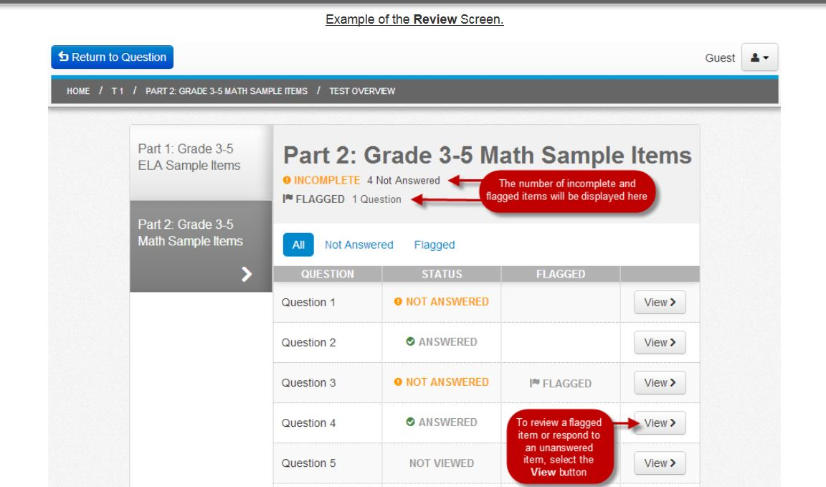

Slide 18
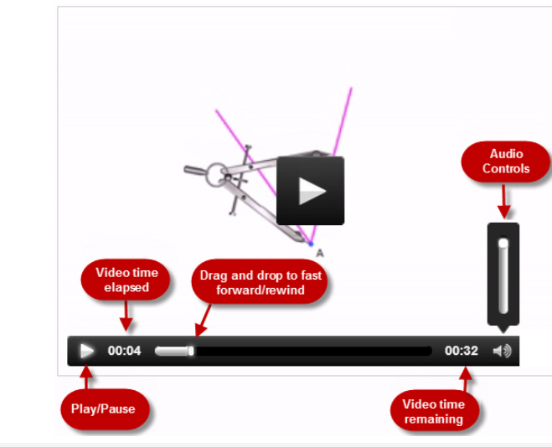
Using the Video Player

Slide 19
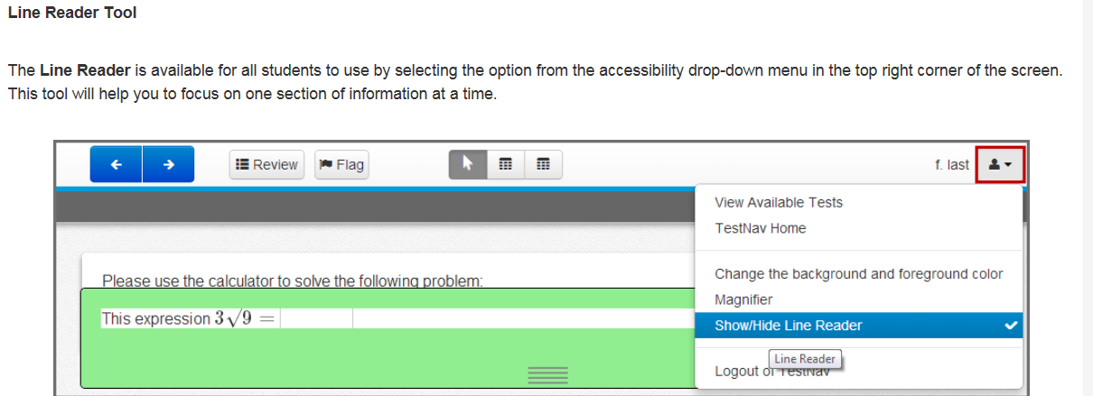
Line Reader Tool

Slide 20
Zoom Tool

Slide 21
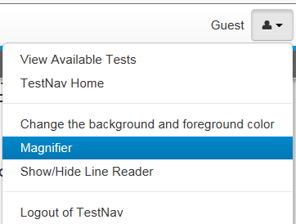
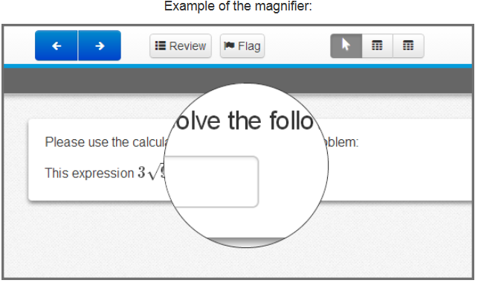
Magnifier

Slide 22
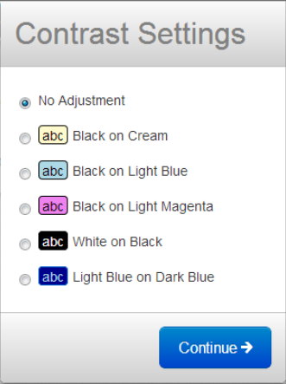
Changing the Background

Slide 23
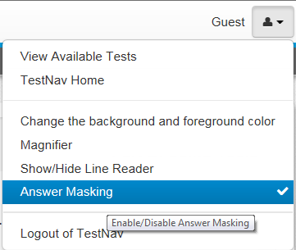
Answer Masking

Slide 24
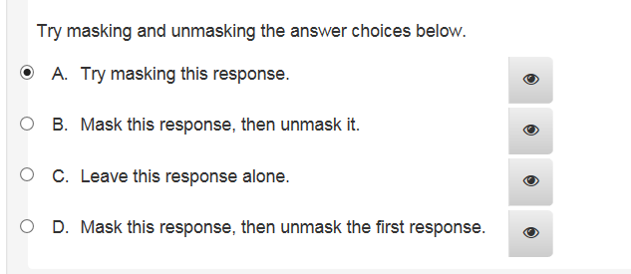
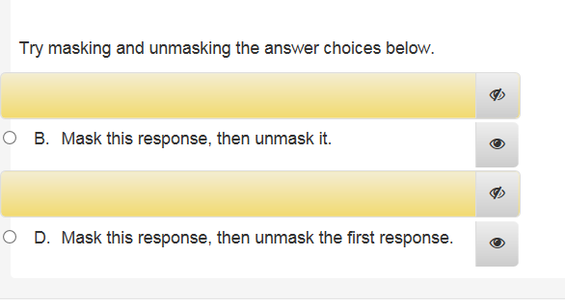

Slide 25
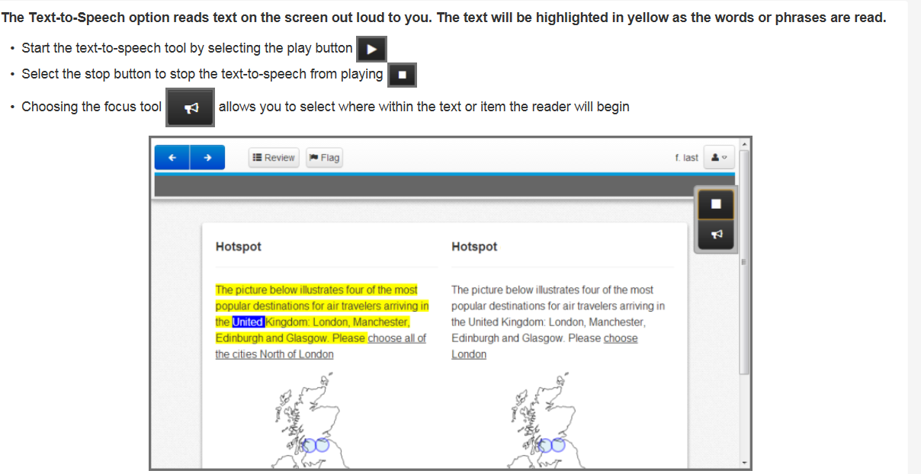
Text to Speech Option

Slide 26
Using the Video Player

Slide 27
Using the Scrollbar

Slide 28
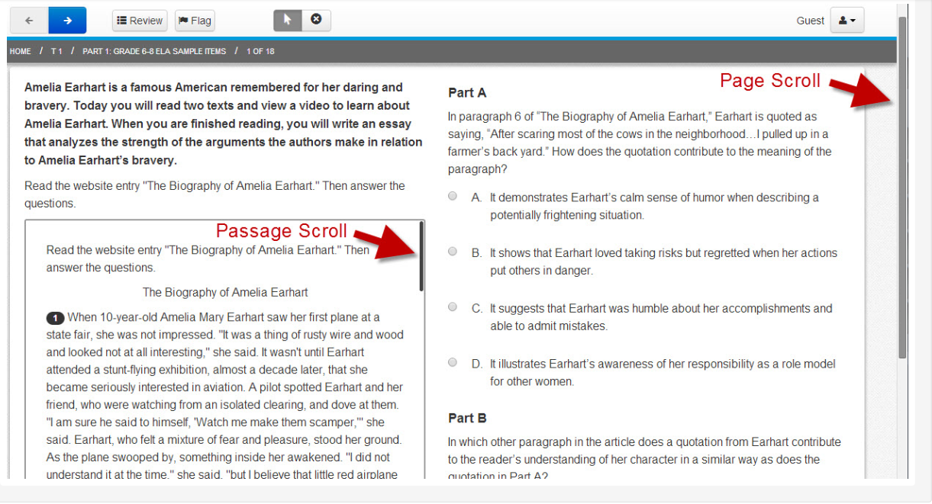

Slide 29
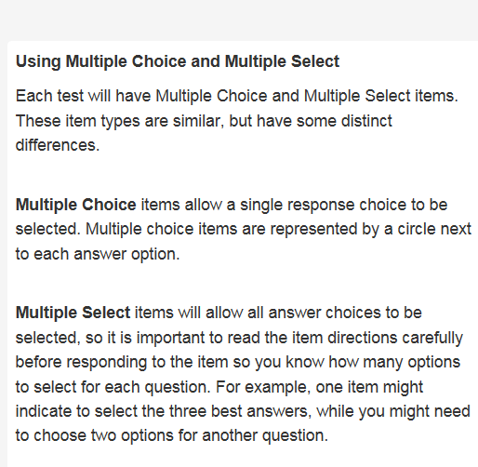
Difference between Multiple Choice and Multiple Select

Slide 30
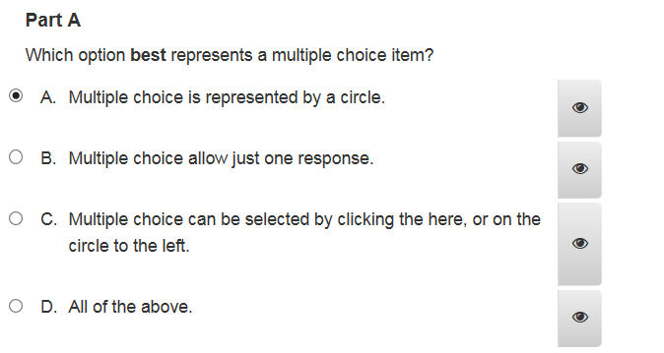
Multiple Choice/Circle
Only one answer

Slide 31
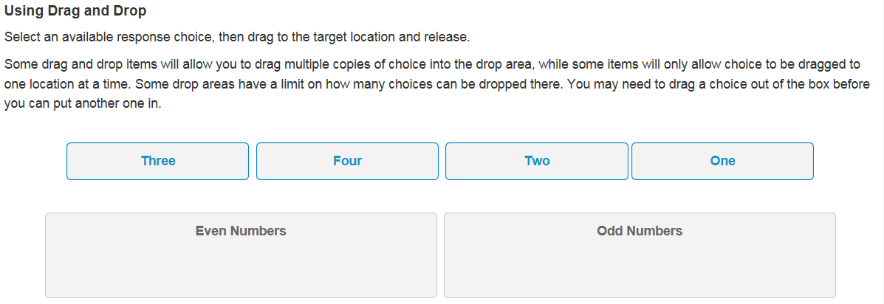
Drag and Drop

Slide 32
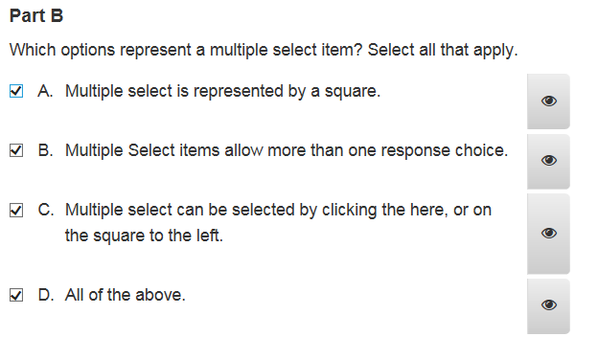
Multiple Select/Square
More than one answer

Slide 33
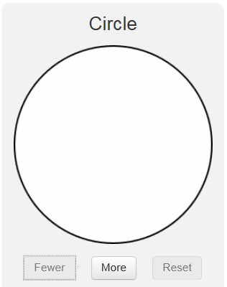
Fraction Model

Slide 34
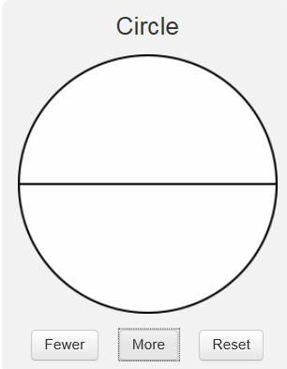
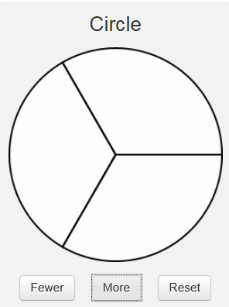
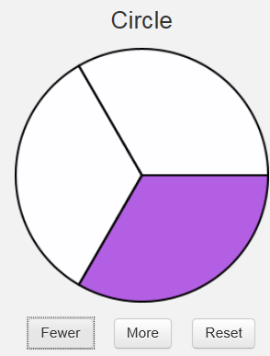
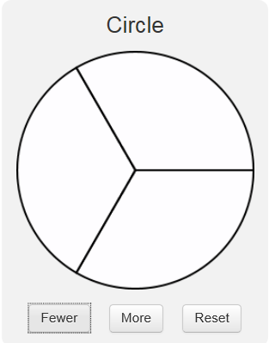
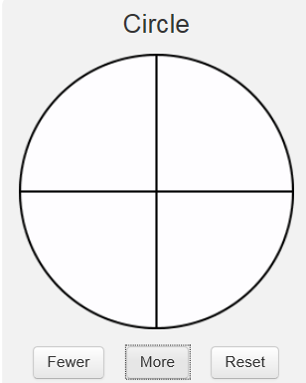
Reset brings you back to blank circle

Slide 35
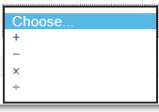
Drop Down for Math Problems

Slide 36
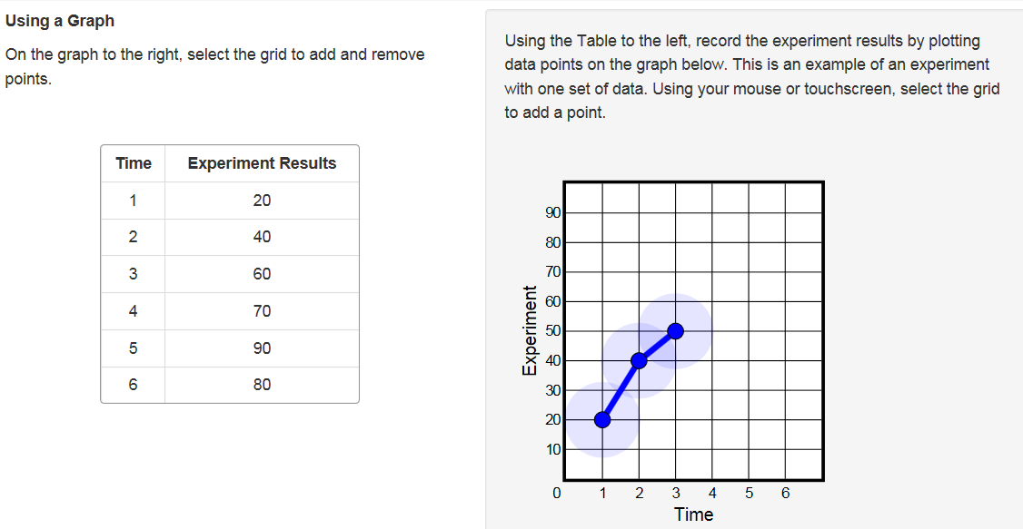
Using a Graph

Slide 37
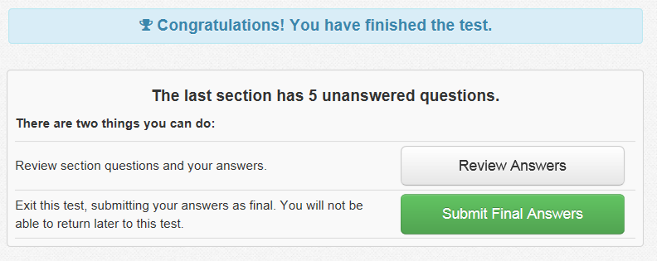

Slide 38
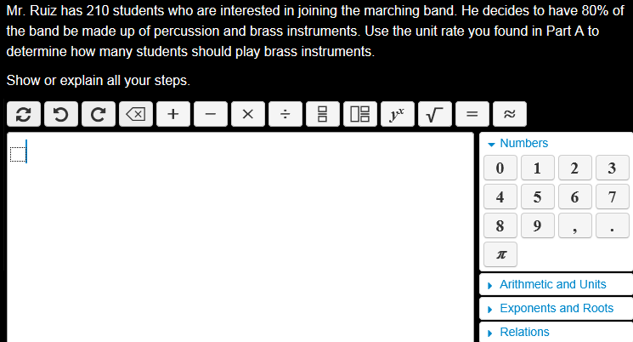
Sample Open-ended Math Item

Slide 39
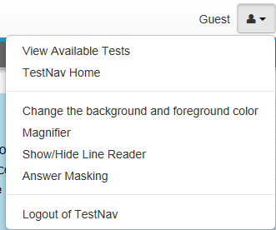
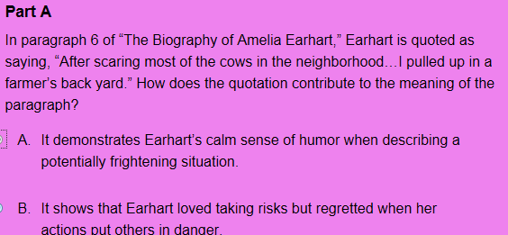
Assessment Tools
Previous or next test page
Flag – to Review test question later
Used to eliminate answers

Slide 40
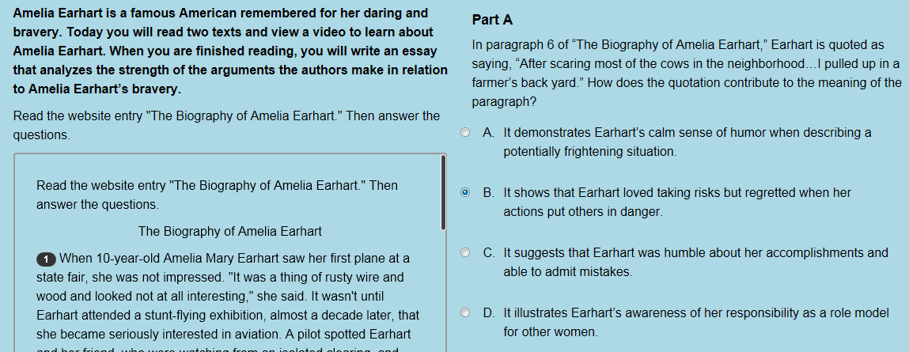
Reading the Questions
Multiple Choice Items
Numbered Paragraphs
Use the scroll bar to view entire passage

